Slide 1


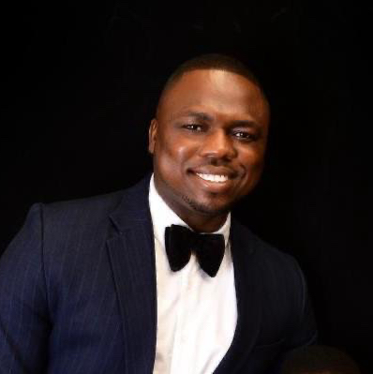
Getting to Know Me
Work
Personal
My role
Procurement of Cashew and Cocoa
Signifiicant others / family members / furry friends in my life
Angela(Wife), Tomi(son) & Nifemi (daughter)
Tenure in ofi/Olam
14 years
How I enjoy spending my free time
Reading and watching movies
Previous companies I have worked at
Wema Bank Nigeria
My favorite / comfort food
Jollof rice
Why I joined ofi/Olam and what keeps me here?
Entrepreneurship culture and global ambition of the company.
My favorite song
Good sound with meaningful lyrics
Kayode Abolarin
‘Kayode’
I enjoy dancing and playing football
This is me outside work, doing stuff I enjoy in my life …

